Slide 1

WELCOME EVERYONE
TO
OUR Project PRESRNTATION

Slide 2
I am
Jannatul Khould Neju
&
My Project is
Airline
Management System

Slide 3
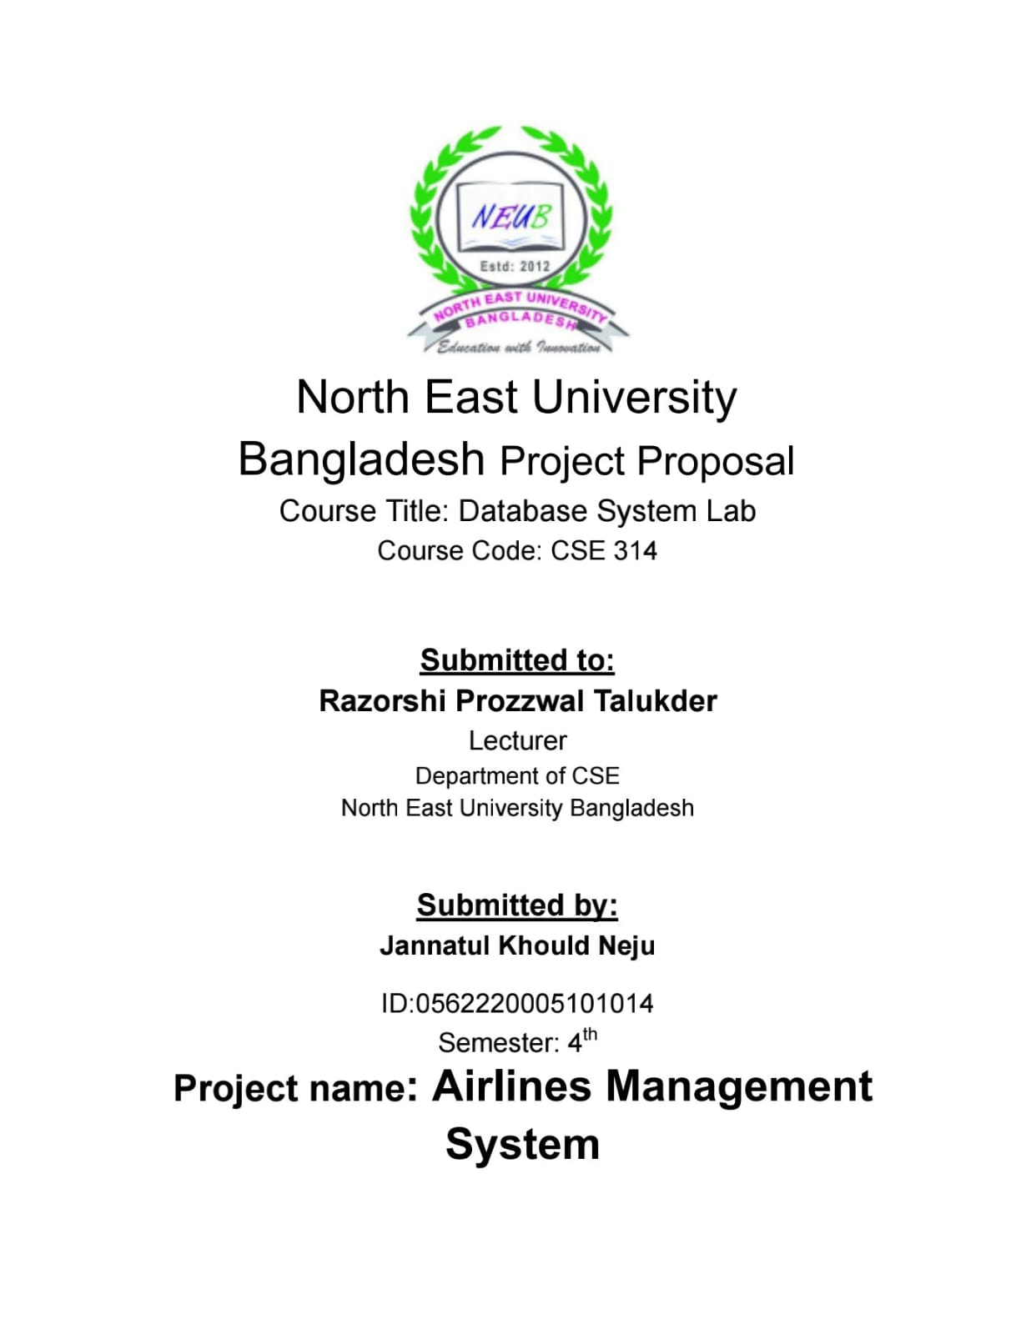
1. Project Proposal

Slide 4
Project Overview:
This system is designed to streamline and automate various aspects of airline
management, such as ticket booking, Manage flight , and passenger information
management , ticket cancellation. My project is built using Java, with a focus on
object-oriented programming principles and design patterns. We utilize a MySQL
database to store and manage all the data related to the airlines' operations,
including passenger information, and booking records.

Slide 5
Key Feature
Manage Flight
Ticket Booking
Ticket Cencellation
Manage Passenger

Slide 6
3.Technology Stack:
- Frontend: Java Swings, AWT, JFrame
- Database: MySQL
- Security: Implementing best practices for secure transactions and user data

Slide 7
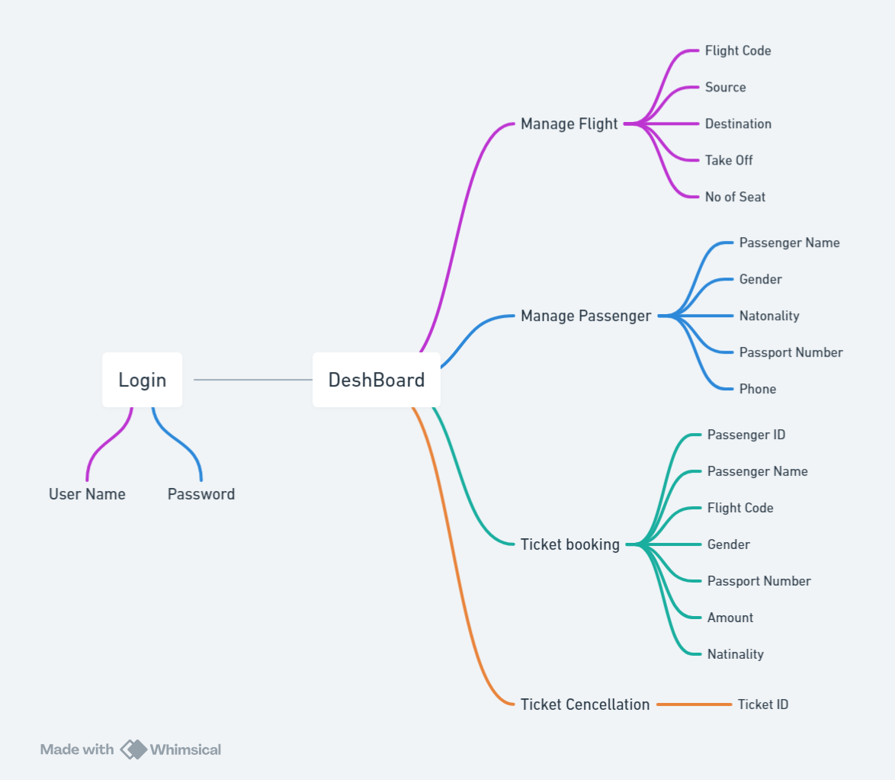
2. Dtabase
Flowchart

Slide 8
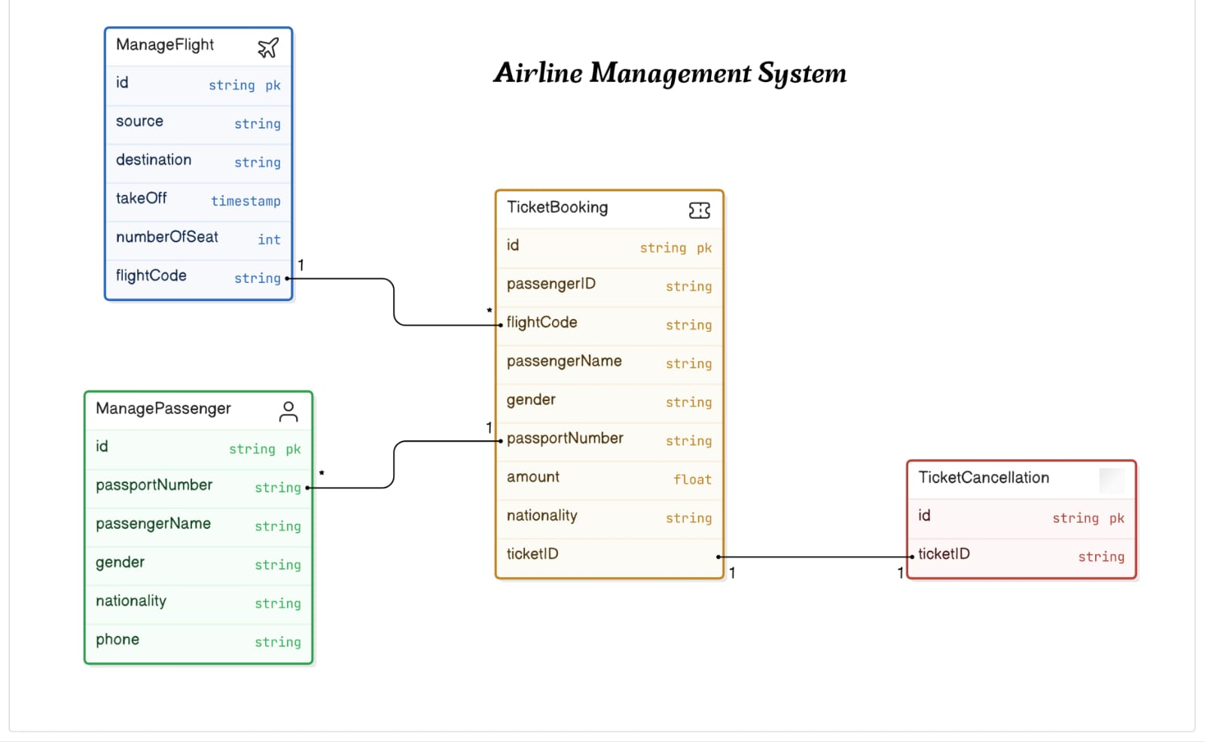
3. Database
Design

Slide 9
Here is some
Project
Demo

Slide 10
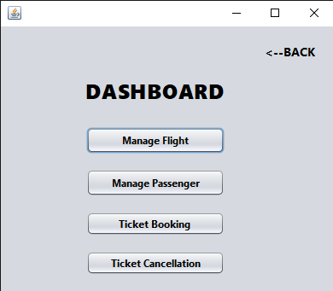

Slide 11
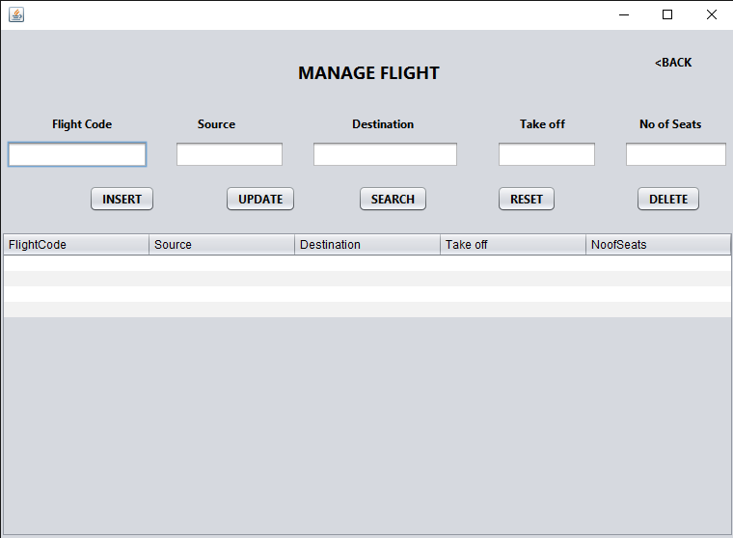

Slide 12
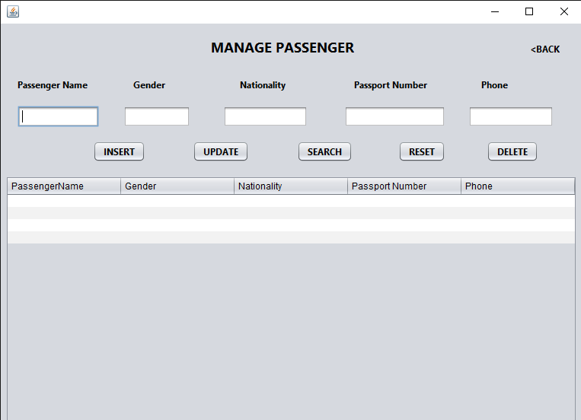

Slide 13
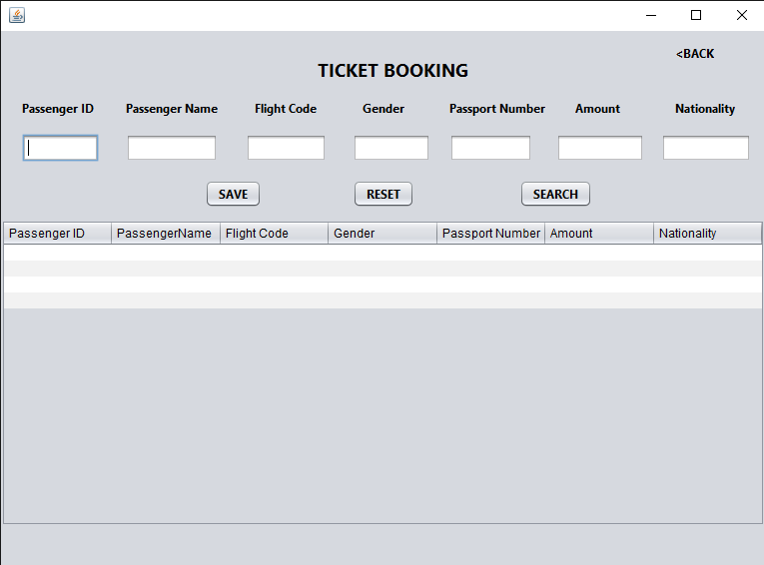

Slide 14
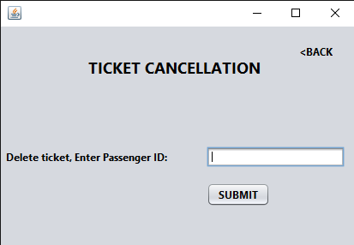

Slide 15
The End
Thank You

